Slide 1
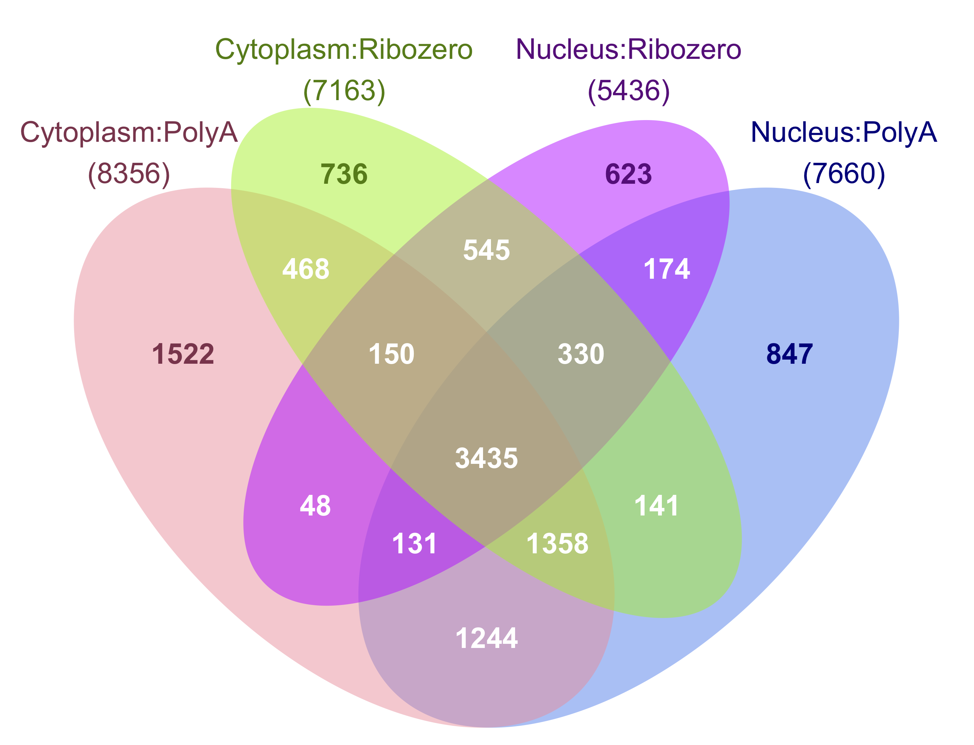
A.
B.
C.
D.
Figure 1: Developmental gene expression changes in human cortex are similarly detectable in nuclear and cytoplasmic RNA
Principal component analysis. PC1 separates the samples by age and PC2 separates the samples by library type so that nuclear and cytoplasmic samples from the same donors cluster together.
Bar plot showing the number of genes with increasing or decreasing expression by age in cytoplasmic and nuclear RNA sequenced using PolyA and Ribozero library preparation at three False Discovery Rate (FDR) cutoffs and two log₂ fold change (LFC) cutoffs.
LFC of gene expression across age measured in cytoplasmic and nuclear RNA (PolyA library preparation shown only).
Venn diagram of differentially expressed genes by age (FDR≤0.05; abs(LFC)≥1) measured in both RNA fractions and library types. The total genes for each group are listed in parentheses.

Slide 2
A.
B.
C.
D.
Nucleus
Prenatal
Cytoplasm
Adult
E.
F.
Nucleus
Cytoplasm
Figure 2: Prenatal and adult human cortex show distinct patterns of RNA localization across the nuclear membrane.
MA plots of prenatal and adult gene expression differences across fraction. Red dots indicate FDR≤0.05.
Log₂ fold change (LFC) of gene expression across fraction in adult samples plotted against prenatal samples. Blue dots indicate genes with agreeing sign, and red indicate a change in LFC direction.
Annotation of groups of genes differentially expressed by fraction (FDR≤0.05; abs(LFC)≥1). The total number of genes in each group is listed to the right of each bar.
LFC of expression by age in cytoplasmic and nuclear RNA in genes retained or exported in adult samples, stratified by FDR threshold.
Annotation of groups of genes differentially expressed by age (FDR≤0.05; abs(LFC)≥1). The total number in each group is listed to the right of each bar.
LFC of expression by fraction in adult samples in groups of genes with increasing or decreasing expression by age, stratified by false discover rate threshold.

Slide 3
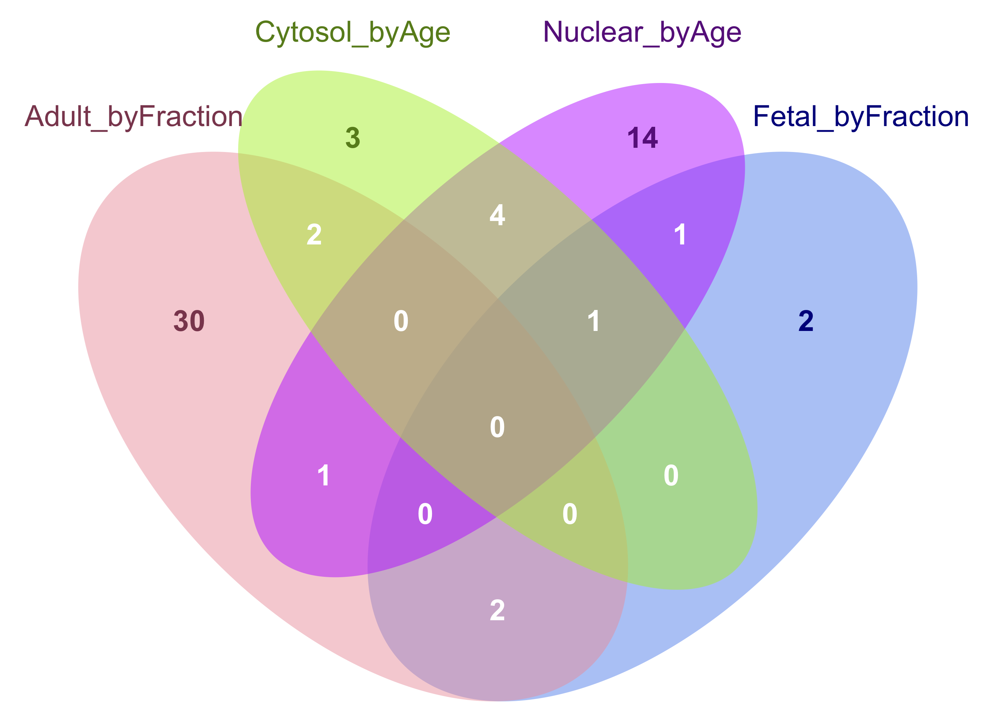
A.
B.
C.
D.
Nuc.
Cyt.
E.
F.
Pren.
Nuc.
Adult.
Cyt.
Figure 3: Intron retention patterns in prenatal and adult human cortex associate with RNA distribution.
Proportion of junction reads per sample by group. Prenatal cortex has a higher proportion of splice junctions than adult, and although Ribozero samples have a lower proportion of junctions in nuclear samples, polyA samples show non-significantly different proportions between fractions.
Percent of skipped exons (SE), skipping of two exons (S2E), intron retention (IR), mutually exclusive exons (MXE), proximal and distal alternative 5’ splice site use (A5SS.P and A5SS.D), proximal and distal alternative 3’ splice site use (A3SS.P and A3SS.D), alternative first exon use (AFE) and alternative last exon use (ALE)
F
F
F
dIRs by fraction in adult were depleted in genes greater expressed in prenatal than adult (OR<0.30, FDR<0.005), while dIRs by age in nuclear RNA were enriched in genes greater expressed in nucleus than cytoplasm (OR<8.98, FDR<9.8e-4) and

Slide 4
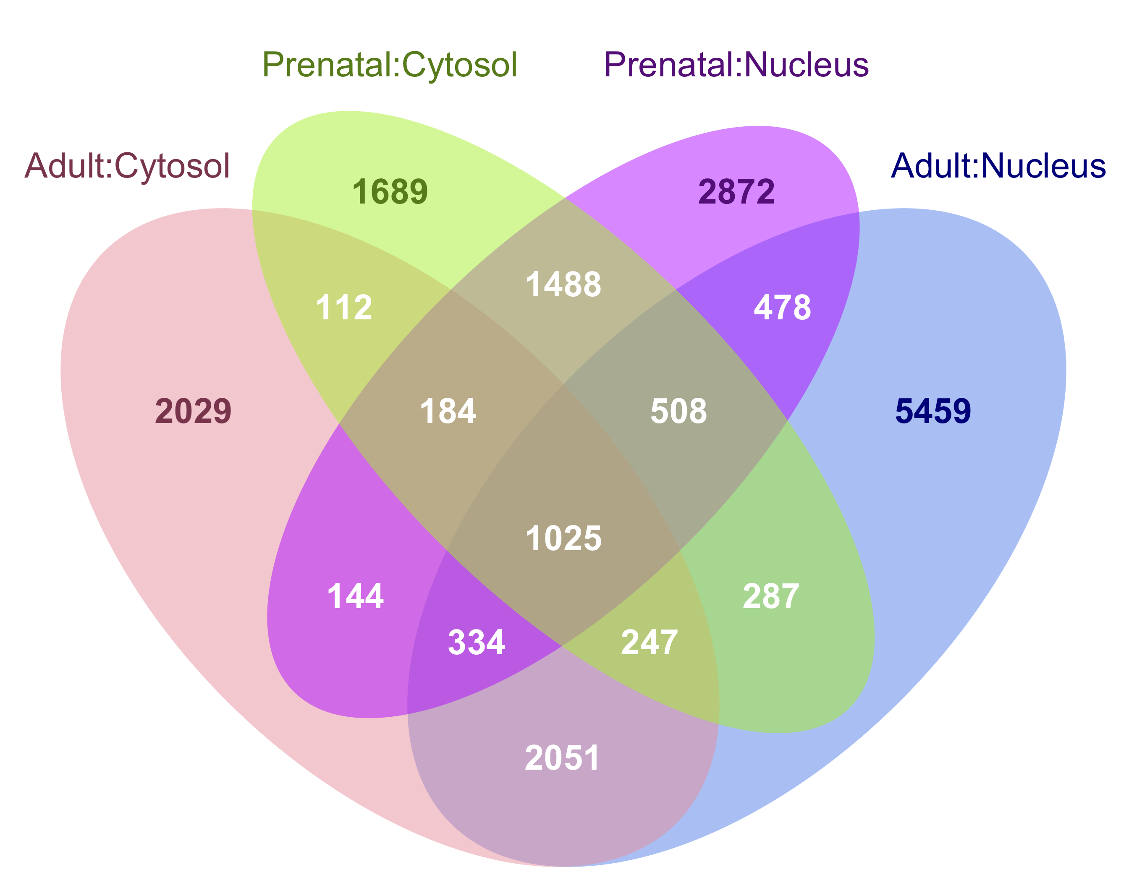
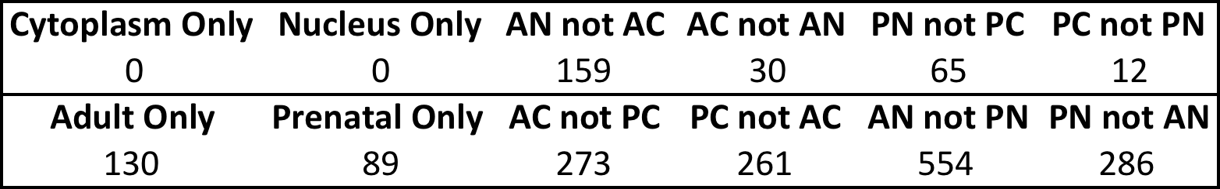
A.
B.
D.
C.
E.
Figure 4:
abcd

Slide 5
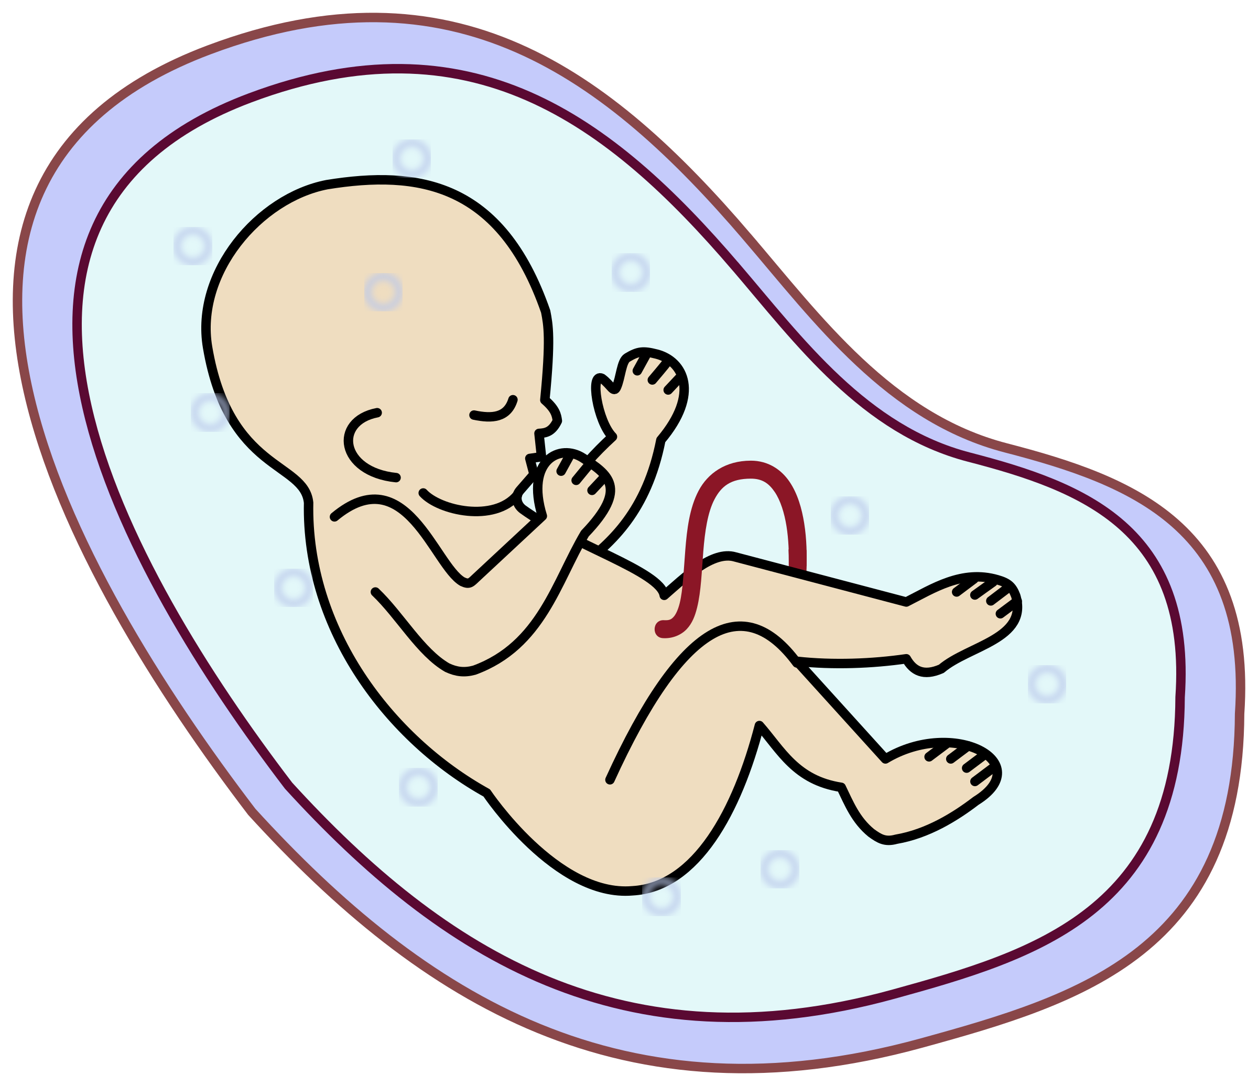

Homogenate brain tissue
RNA Fractionation
Sequencing Library Preparation
PolyA+ (N=3)
Cytoplasmic
RiboZero (N=3)
3 Fetal Brains (PFC)
PolyA+ (N=3)
Nuclear
RiboZero (N=3)
PolyA+ (N=3)
Cytoplasmic
RiboZero (N=3)
3 Adult Brains (DLPFC)
PolyA+ (N=3)
Nuclear
RiboZero (N=2)
Supplementary Figure 1: Experimental Design
We characterized the nuclear and cytoplasmic transcriptome in human prenatal postmortem prefrontal cortex (PFC) and adult postmortem dorsolateral prefrontal cortex (DLPFC) using two RNA sequencing library preparation methods. “PolyA” library preparation selects polyadenylated transcripts via a pull-down step, while “Ribozero” library preparation relies on a rRNA depletion step.

Slide 6
A.
B.
C.
⬆ Nucleus
⬆ Cytoplasm
D.
Supplementary Figure 2: Characterizing the nuclear and cytoplasmic transcriptome in human brain
Differentially expressed genes by library type (FDR ≤ 0.05; abs(Log2 Fold Change) ≥ 1).
ACTB1, a cytoplasmic gene, and MALAT1, a nuclear gene, are enriched in the appropriate subcellular fractions.
Percent of reads mapping to six genomic features in each group.
Proportion of reads including a splice junction by group.
Length distribution of genes enriched by fraction in polyA samples.
Principle component analysis where PC1 captures variance due to age and PC2 captures library type.

Slide 7
A.
B.
C.
D.
Supplementary Figure 3: Comparing Fraction and Age in RiboZero Samples
MA plots of prenatal and adult gene expression differences measured across fraction. Red dots indicate FDR≤0.05.
Log₂ fold change (LFC) of expression across fraction in adult samples plotted against prenatal samples. Blue dots indicate genes with agreeing sign, and red indicate a change in LFC direction.
Annotation of groups of genes differentially expressed by fraction in adult and prenatal RNA (FDR≤0.05; abs(LFC)≥1). The total number in each group is listed to the right of each bar.
Annotation of groups of genes differentially expressed by age in cytoplasmic and nuclear RNA (FDR≤0.05; abs(LFC)≥1). The total number in each group is listed to the right of each bar.

Slide 8
A.
B.
C.
D.
Supplementary Figure 4: Alternative splicing and intron retention

Slide 9
A.
B.
C.
D.
Supplementary Figure 5: Intron retention
Quality controls plots showing the

Slide 10
A.
B.
C.
D.
D.
E.
F.
G.
H.
Supplementary Figure 6: RNA editing
Quality controls plots showing the

Slide 11
A.
B.
C.
D.
E.
F.
Supplementary Figure 7: Disease Semantic and Ontology Enrichment
Enrichment for disease ontology terms in “Interaction” genes whose expression varies by both fraction and age (FDR ≤ 0.05; abs(LFC ≥ 1). The gene ratio for each term is listed in white.
ALDH2 gene expression as measured in log reads per kilobase per million mapped reads (RPKM) plus one read, grouped by age (adult (A) or prenatal (P)) and fraction (cytoplasm and nucleus).
ELK1 gene expression as measured in log(RPKM+1).

